Slide 1
Create Your Own Self-Service Cloud: Docker Containers as Part of a CD Pipeline
Nikhil Vaze | @therealnikhil | DOES 2015
Notes:
Hello everyone welcome to my session on creating your own self service cloud: docker containers as part of a CD pipeline

Slide 2
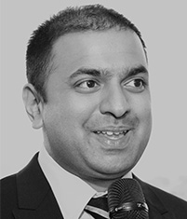
Introductions
Nikhil Vaze
https://github.com/nikhilv
@therealnikhil
Staff Software Engineer at Electric Cloud
Full stack engineer and loves to hack on things.
Johns Hopkins University Alum
Notes:
Hi everyone my name is Nikhil Vaze.
I’m a Staff Software Engineer at Electric Cloud.
Been there for about 5 years and I’m the team lead for all of our plugins (third-party integrations).
And you can find me on github and twitter
I work at a company that helps other companies develop better software faster. We sell software products that do so. We are not really a consulting shop. We’re a devops automation / tools provider.

Slide 3

































Electric Cloud: Powering Continuous Delivery
CONTINUOUS
ElectricAccelerator
ElectricFlow
DEV
OPS
Build & Test Acceleration
Pipeline Management and Visibility
Build
Test
Deploy
Build
DevOps Automation Platform (ElectricFlow)
DELIVERY
Plugs right in to
your existing tools
Notes:
A few slides about ElectricCloud and my role. This is not a sales pitch. This is a quick recap
I work on the ElectricFlow product.
ElectricFlow provides end to end pipeline automation and governance to help our customers build, test, and deploy at scale, making releases automated, predictable, and routine. It also provides easy integration our customers favorite tools if desired so that you can track everything.
One of the most important questions: How does this technology solve my business problems?

Slide 4





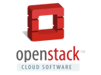




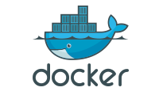



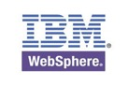
I spend my time on integrations
Source Control, Defect Tracking, Databases, Clouds, Testing tools , Application Servers….
Notes:
Plugins and integrations mean so many things. And it seems like every piece of software has a concept of a plugin. Or an app.
Gradle plugins, Android applications, Chrome extensions, Eclipse plugins.
Here are some of the various technologies my team has worked on in the past year.
Our product needs to be able to check out from a source control system like git or svn, build using compilation tools like maven or ant, test using automated test frameworks like selenium, update tickets on ticketing systems like JIRA or Rally and then deploy to application servers like Jboss or WebSphere servers running on cloud providers like Azure or Amazon.

Slide 5
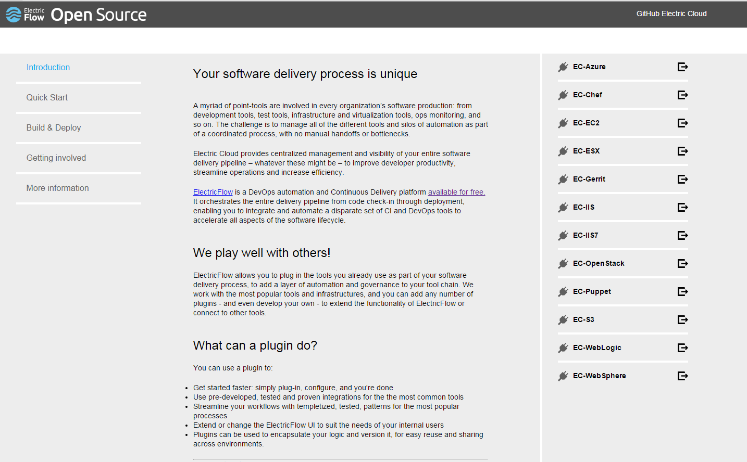
Our integrations are going Open Source
https://electric-cloud.github.io/
Notes:
Plugins and integrations mean so many things. And it seems like every piece of software has a concept of a plugin. Or an app.
Gradle plugins, Android applications, Chrome extensions, Eclipse plugins.
Here are some of the various technologies my team has worked on in the past year.
Our product needs to be able to check out from a source control system like git or svn, build using compilation tools like maven or ant, test using automated test frameworks like selenium, update tickets on ticketing systems like JIRA or Rally and then deploy to application servers like Jboss or WebSphere servers running on cloud providers like Azure or Amazon.

Slide 6
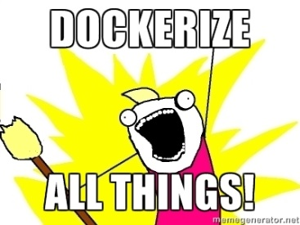
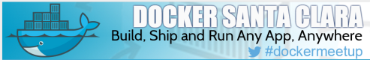
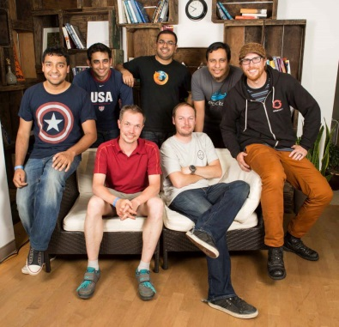
Experience with Docker
General interest in Docker, containers and application deployment.
Docker Santa Clara Co-organizer:
http://www.meetup.com/Docker-Santa-Clara/
Docker Hackathon 2014
http://blog.docker.com/2014/07/dockercon-video-dockercon-hackathon-winners/
Lightning demo @ DOES ‘14
Docker and Application Deployment
Notes:
I wear Docker tshirts all the time.
Coorganizer of Docker Santa Clara
Did pretty well at the Docker hackathon back in 2014 with the handsome gentleman in the back named Tanay Nagjee

Slide 7

Docker Survey: Keep your hands up if …
If you’ve heard of Docker
You’ve typed ‘docker run…’
You use docker in dev/test
You use docker in production
You have exported a docker container and run it with systemd-nspawn
Notes:
Just so I can calibrate this talk…

Slide 8
Overview: The pain of procuring new IT systems

Slide 9
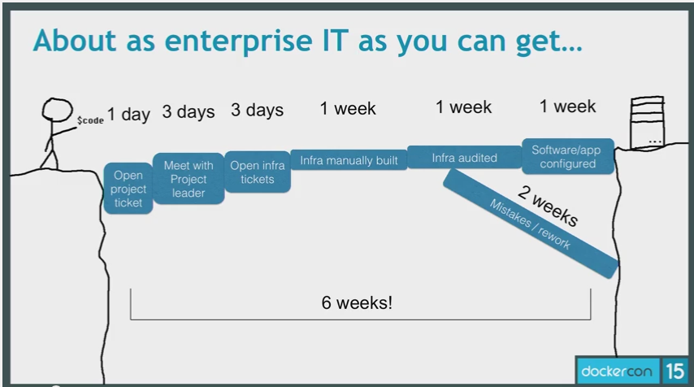
Ring a bell?
Source Docker Con 2015: https://www.youtube.com/watch?v=RaSzmFkf4fM
Notes:
This was presented by GE on the steps and length of time it takes to get a piece of code onto machines
In the end GE went from months to minutes by creating a self service portal and they put their software into Docker containers

Slide 10
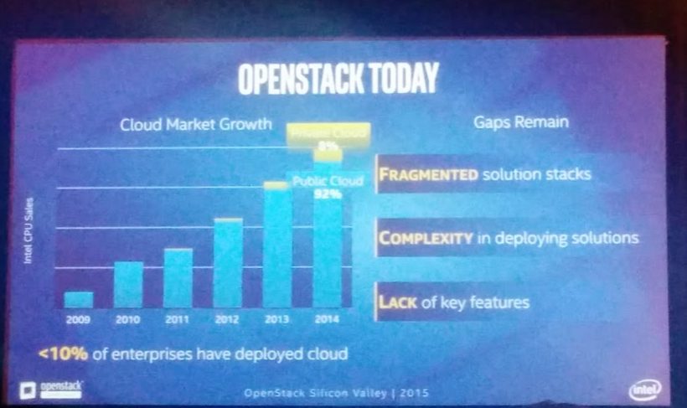
Enterprises have not adopted the cloud
Source: Intel presentation @ OpenStack Silicon Valley 2015
Notes:
Industry use case. You don’t have to take my word or EC

Slide 11
Fortune 500 use case

Slide 12

Fortune 500 company (repeat picture)
Source Docker Con 2015: https://www.youtube.com/watch?v=RaSzmFkf4fM

Slide 13
Challenges
One group provides infrastructure.
Another group provisions software on top of the infrastructure.
Another group performs the data load onto the software/infrastructure.
Cons:
Quite expensive. Front loaded. If you want this particular app loaded for testing. It will involve x thousands of dollars of cost.
Process encouraged bad behavior. Users were requesting infrastructure and never letting it go.

Slide 14
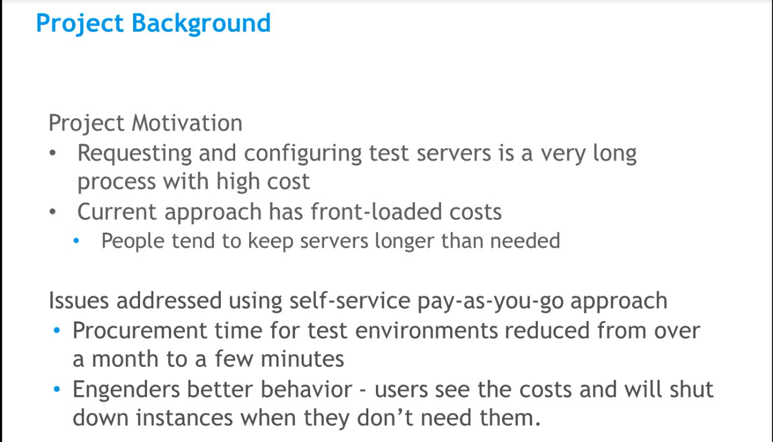
(The Actual slide)

Slide 15

Enter Electric Cloud!

Slide 16
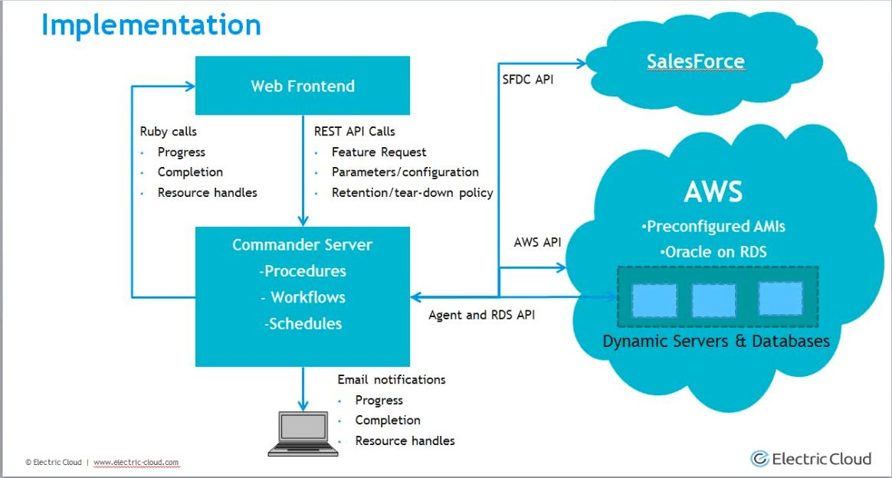

Slide 17
Question we (Electric Cloud) asked ourselves ~ early 2014
Who else was facing this?
Could we make this a feature?
Does the introduction of Docker change things?

Slide 18
Dynamic Environments / Self Service Clouds

Slide 19
Answers we (Electric Cloud) gathered~ mid/late 2014
Who else was facing this?
Common problem facing the industry
Could we make this a feature?
Yes.
Does the introduction of Docker change things?
Yes. And it’s the future.

Slide 20
What are Dynamic environments?
Define once, provision repeatedly
Define a blue print. Make it available to your users
Cloud ready
Apply the blue print to your cloud
Configuration Management ready
Already have a blue print in your CM tool? No problem!
Docker ready

Slide 21
Intro Docker*

Slide 22
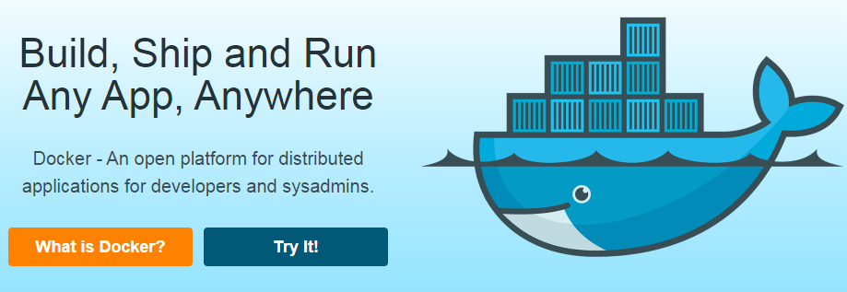
Enter Docker
https://docker.io/
Open Source
Used to wrap LXC, now has its own container implementation
Really, really fast. Start measuring in milliseconds

Slide 23
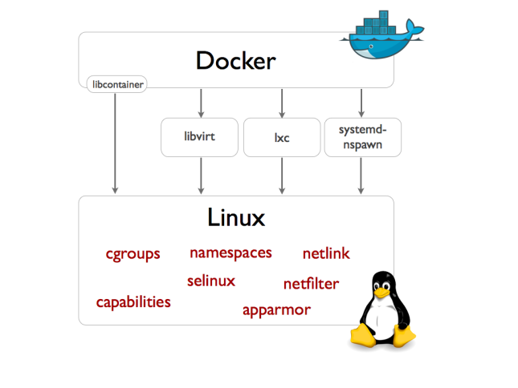
Docker 102 – Different drivers
Notes:
https://blog.docker.com/2014/03/docker-0-9-introducing-execution-drivers-and-libcontainer/
Second, we are introducing a new built-in execution driver which is shipping alongside the LXC driver. This driver is based on libcontainer, a pure Go library which we developed to access the kernel’s container APIs directly, without any other dependencies.
Thanks to libcontainer, Docker out of the box can now manipulate namespaces, control groups, capabilities, apparmor profiles, network interfaces and firewalling rules – all in a consistent and predictable way, and without depending on LXC or any other userland package. This drastically reduces the number of moving parts, and insulates Docker from the side-effects introduced across versions and distributions of LXC. In fact, libcontainer delivered such a boost to stability that we decided to make it the default. In other words, as of Docker 0.9, LXC is now optional. To switch back to the LXC driver, simply restart the Docker daemon with docker -d -e lxc. Of course we will continue to support the LXC driver going forward.

Slide 24
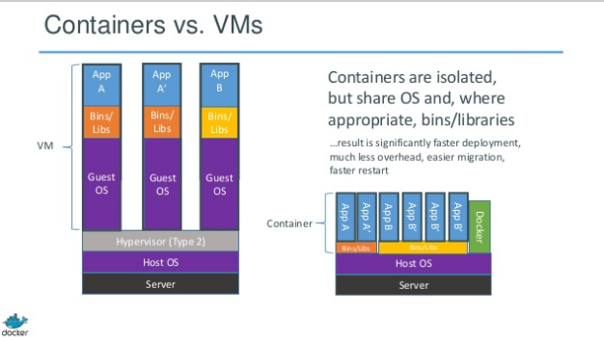
Docker 102 containers vs. VMs

Slide 25
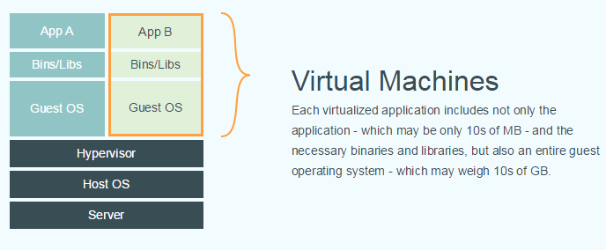
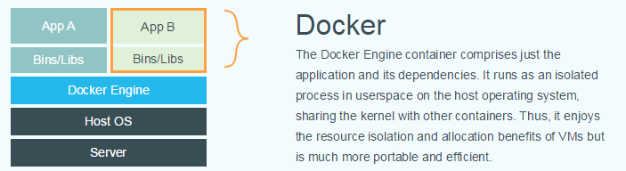
Docker 102 VMs vs. Docker

Slide 26
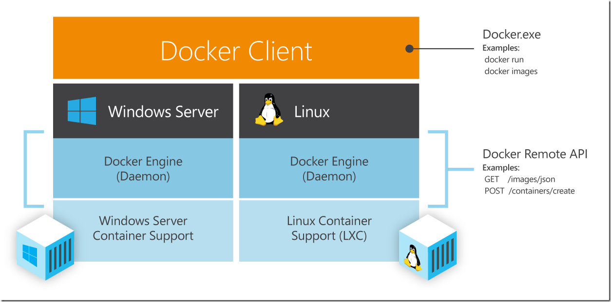
Docker 102, Docker Client, Docker Engine

Slide 27
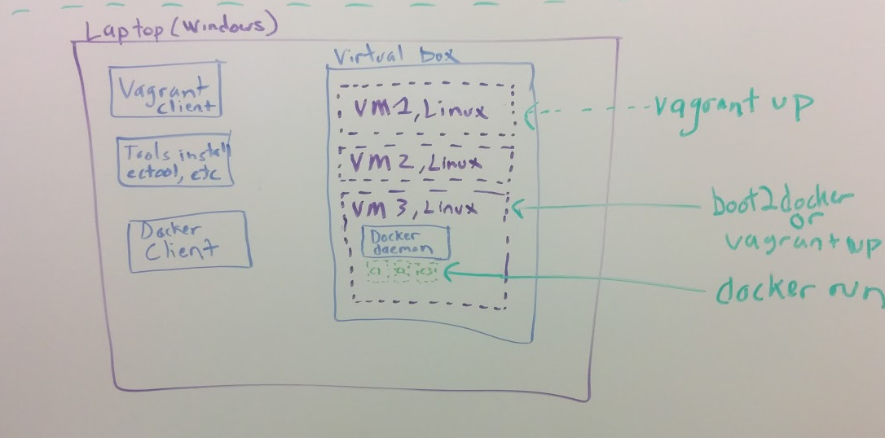
Docker 102 Diagram of potential Flow dev

Slide 28
Why are people excited about containers?
Builds can be done inside the container, gives file system isolation and reproducibility.
Development/Production Parity. The container is the deployable artifact.
Container start up times measured in milliseconds
Microsoft getting on board!

Slide 29
Explanation of demo

Slide 30
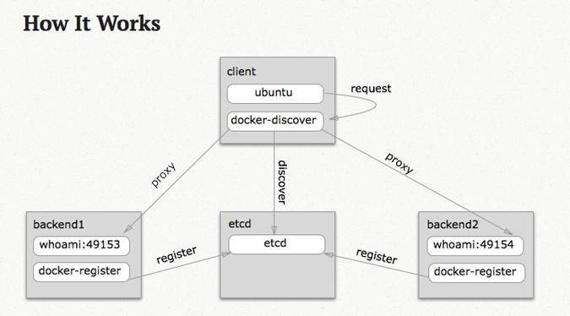
Blog post I’ve extended for this following for this talk
Docker Service Discovery Using Etcd and Haproxy
http://jasonwilder.com/blog/2014/07/15/docker-service-discovery/
Notes:
Shout out to Jason Wilder
We have components to serve as a registry (etcd)
A registration side-kick process (docker-register)
A discovery side-kick process (docker-discover)
Finally a consumers (chrome)

Slide 31
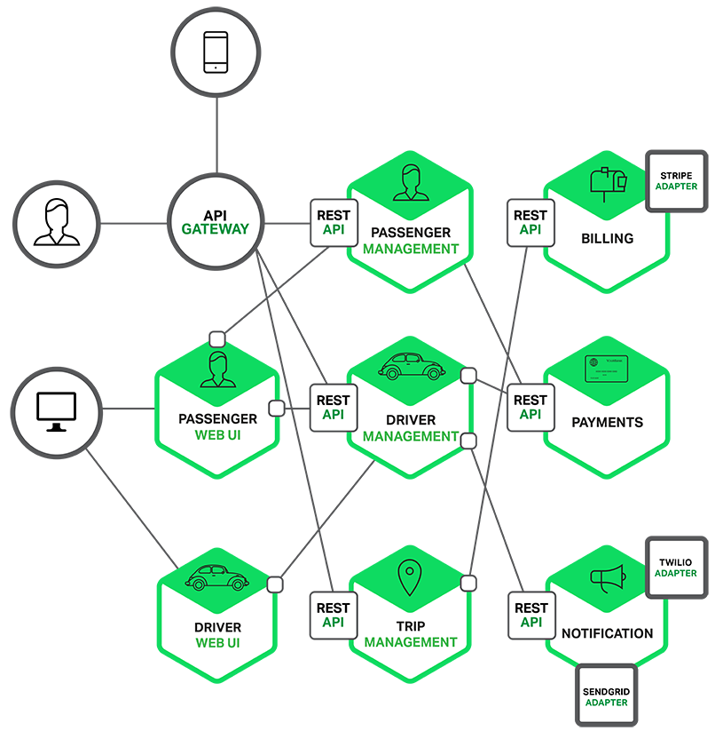
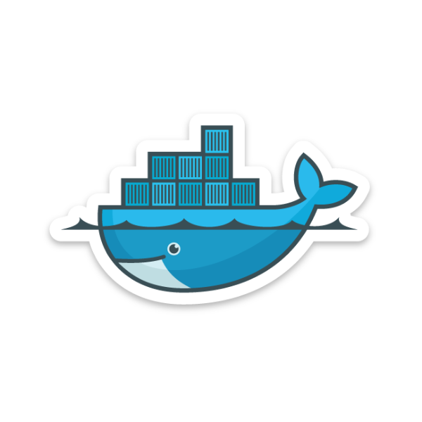
Dockerized App in Prod
Load Balancer
HA Proxy
Availability Zone A
Application
Service Discovery
etcd
NoSQL Database
Couchbase
Notes:
Multi node (vm), multi container application deployments
stateful

Slide 32
Multi AZ Dockerized App
Load Balancer
HA Proxy
Availability Zone A
Availability Zone B
Application
Service Discovery
etcd
Application
NoSQL Database
Couchbase
NoSQL Database
Couchbase

Slide 33
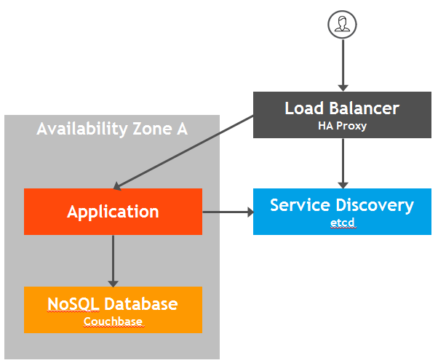
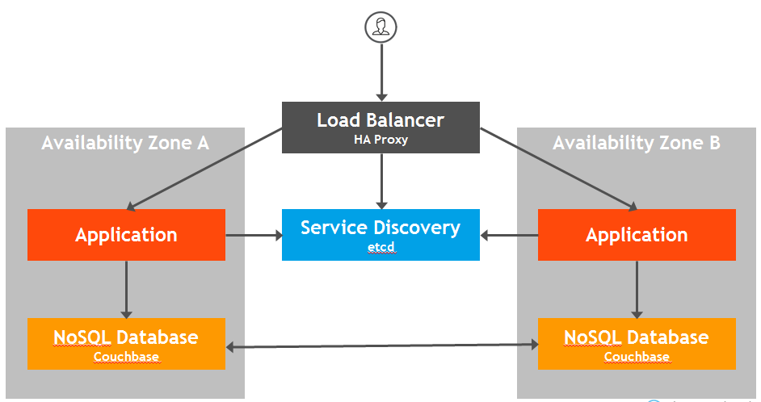
Comparison
Before
After
Notes:
Multi node (vm), multi container application deployments
Stateful

Slide 34
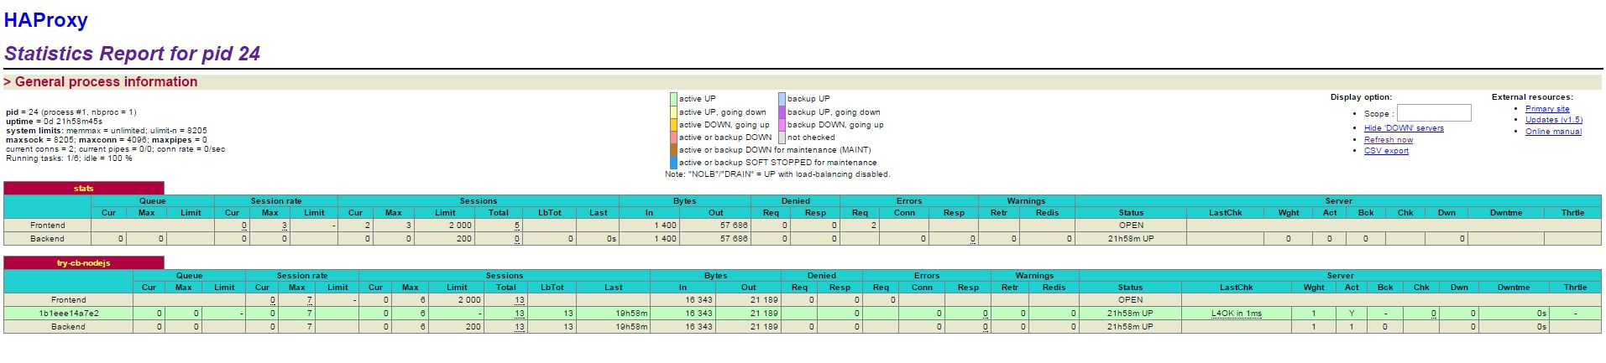
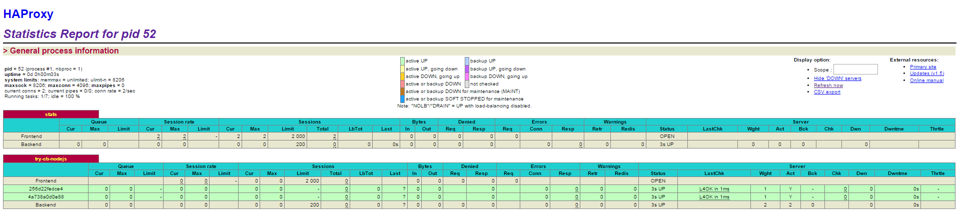
Load Balancer (HAProxy)
Notes:
Multi node (vm), multi container application deployments
Stateful

Slide 35
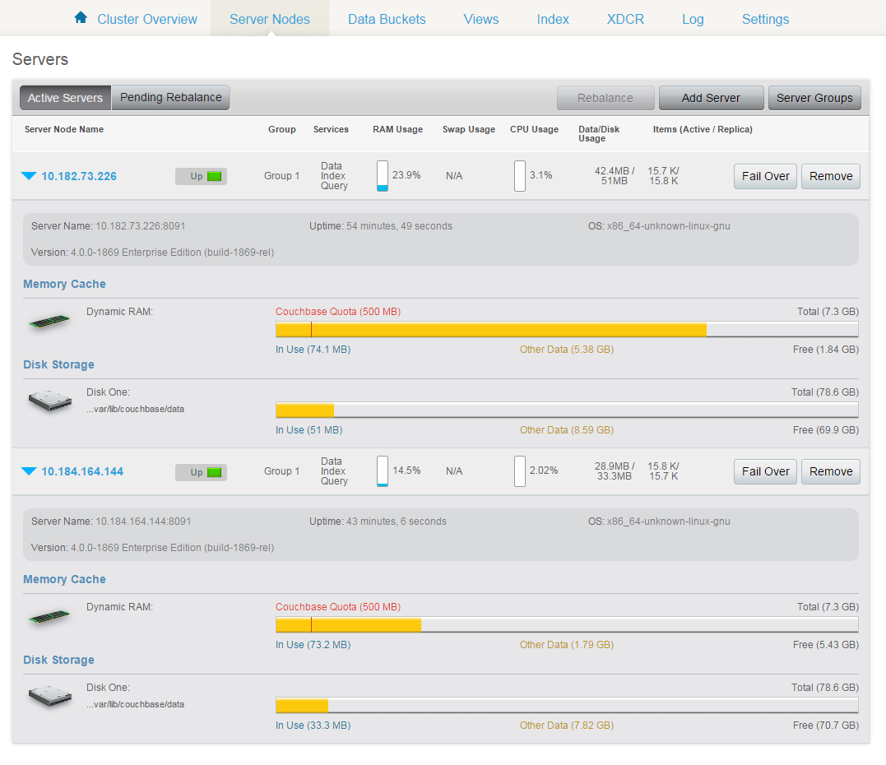
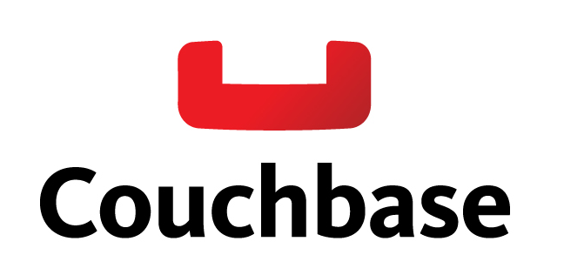
Couchbase
- NoSQL DB
- One Dimensional or Multi Dimensional Scaling
- Rebalancing
More info:
http://blog.arungupta.me/getting-started-with-couchbase-using-docker/
Notes:
Multi node (vm), multi container application deployments
Stateful

Slide 36
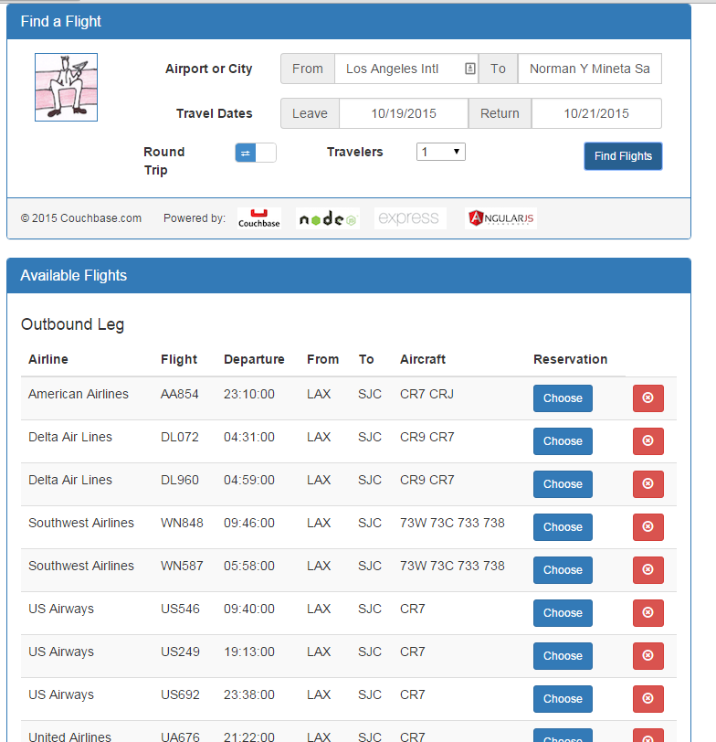
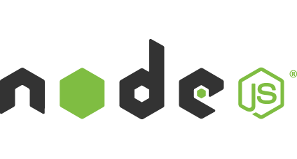
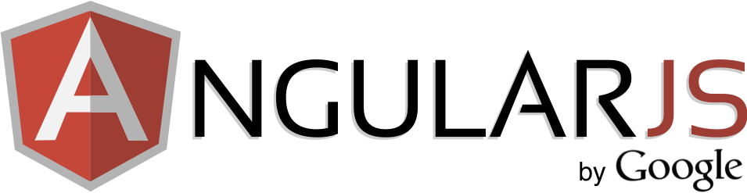
Front end
Created by Couchbase employees
Node.js, Angular.js and Express front end
Github: https://github.com/tleyden/try-cb-nodejs

Slide 37

Etcd (Service Registry)
etcd is a distributed, consistent key-value store for shared configuration and service discovery, with a focus on being:
Simple: curl'able user facing API (HTTP+JSON)
Secure: optional SSL client cert authentication
Fast: benchmarked 1000s of writes/s per instance
Reliable: properly distributed using Raft

Slide 38
Before I forget…

Slide 39
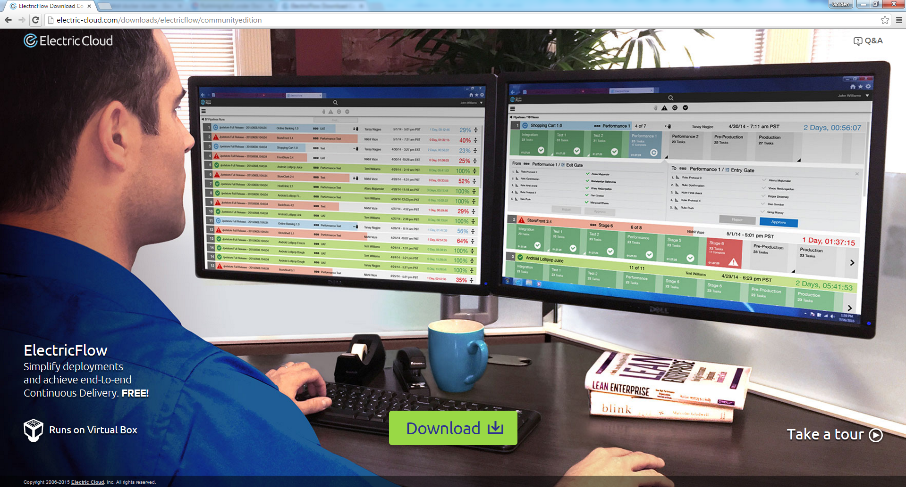
Try out our community edition!
http://electric-cloud.com/downloads/electricflow/communityedition

Slide 40
Demo

Slide 41
Wrap up

Slide 42

Automation & Self Service Clouds, FTW!
Cloud may or may not be first step but doesn’t immediately empower all users.
Self Service can reduce barriers for their users and improve productivity
Docker makes things easier
You need automation!

Slide 43

























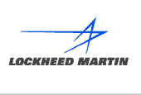


Thank you
Q&A
Networking
Mobile Devices
Semiconductor
ISV, Internet & Entertainment
Financial
Services
Automotive
Medical Devices
Aerospace / Defense
Heavy Industry
Other Systems

Slide 44
etcd
sudo docker run -d -v /usr/share/ca-certificates/:/etc/ssl/certs -p 4001:4001 -p 2380:2380 -p 2379:2379 \
--name etcd quay.io/coreos/etcd:v2.0.8 \
-name etcd0 \
-advertise-client-urls http://${HostIP}:2379,http://${HostIP}:4001 \
-listen-client-urls http://0.0.0.0:2379,http://0.0.0.0:4001 \
-initial-advertise-peer-urls http://${HostIP}:2380 \
-listen-peer-urls http://0.0.0.0:2380 \
-initial-cluster-token etcd-cluster-1 \
-initial-cluster etcd0=http://${HostIP}:2380 \
-initial-cluster-state new
Notes:
How many people have heard of zookeeper or consul?

Slide 45
Docker-register
Runs side by side of the container containing the app you are deploying
HOST_IP=$(hostname --all-ip-addresses | awk '{print $1}')
ETCD_HOST=w.x.y.z:4001
docker run --name docker-register -d -e HOST_IP=$HOST_IP -e ETCD_HOST=$ETCD_HOST -v /var/run/docker.sock:/var/run/docker.sock -t jwilder/docker-register

Slide 46
Docker-discovery
Runs on the ‘load balancer’
ETCD_HOST=w.x.y.z:4001
docker run -d --net host --name docker-discover -e ETCD_HOST=$ETCD_HOST -p 127.0.0.1:1936:1936 -t jwilder/docker-discover

